Slide 1
TIC TAC TOE
BY
PRADEEP KH
MURLIDHAR A
TAYYAB S
SAGAR C

Slide 2
INTRODUCTION
Tic-Tac-Toe, also known as Noughts and Crosses, is a simple two-player game played on a 3x3 grid. The objective is to get three of your symbols (either “X” or “O”) in a row—horizontally, vertically, or diagonally. The game is usually played on paper, but we’ll create a digital version using Python.
Tic-Tac-Toe: A Timeless Duel of Xs and Os
Gameplay
The Grid: Tic-Tac-Toe unfolds on a 3x3 grid, yielding nine squares. Players take turns placing their marks in these squares.
Mark Placement: One player assumes the role of X, while the other becomes O. They alternate turns, strategically choosing where to place their mark.

Slide 3

Winning Conditions:
Horizontal Line: Achieve three Xs or Os in a row across any row.
Vertical Line: Secure three marks in a column.
Diagonal Line: Form a diagonal line of three marks.
Draw Scenario: If all squares are filled without a winner, the game ends in a draw
Objectives of Tic-Tac-Toe
Winning: The primary goal is to form a winning combination of three symbols in a row. The player who achieves this wins the game.
Blocking Opponent: To prevent your opponent from winning, you must strategically place your symbols to block their potential winning moves.
Strategy and Tactics: Tic-Tac-Toe may seem simple, but it involves strategic thinking. Players need to anticipate their opponent’s moves and plan their own moves accordingly.
Fun and Entertainment: Tic-Tac-Toe is a quick and enjoyable game that can be played casually or competitively.

Slide 4
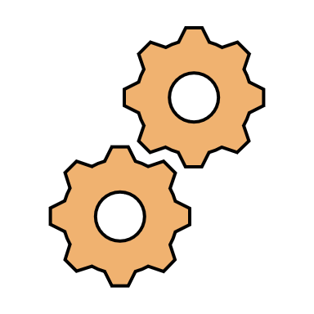
GAME FUNCTIONALITY
2D Array:
A two-dimensional array where each cell represents a position on the board.
e.g: [[' ', 'X', ' '], ['O', ' ', ' '], ...]
This method directly reflects the grid layout and simplifies win condition checks.
Player Turns and Marking Positions:
Keeping track of the current player (X or O). (using flags 0,1),Taking user input for the desired position (e.g., entering a number or clicking a cell on the board).
Validating the user input to ensure it's a valid and empty position on the board.
Updating the game board representation with the player's mark at the chosen position.

Slide 5
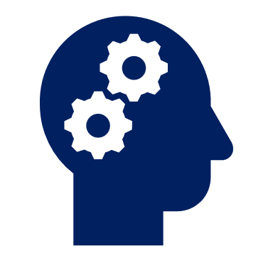
AI in game
AI Representation:
Assign a unique flag value (e.g., -1) to represent the AI player.
AI Decision Making:
The AI needs to decide on its move during its turn. Here are some approaches:
Random Move: A simple approach is to choose an empty position randomly on the board. This is suitable for a basic AI but lacks strategy.
Minimax Algorithm: This is a more sophisticated approach where the AI evaluates all possible future moves and outcomes for both players. It chooses the move that maximizes its chances of winning or minimizes the opponent's chances. Implementing Minimax can be complex for beginners but offers a strategic AI opponent.
Heuristic-based Approach: Define rules or heuristics for the AI to prioritize moves. For example, the AI might prioritize:
Placing its mark to create potential winning lines.
Blocking the opponent's potential winning lines.
Taking the center position if available.

Slide 6
GAME STRUCTURE
Libraries
entry()
main()
Players()
AI()
Button_click()
AI_normal()
AI_hard()
win_condition()
draw_condition()
restart()

Slide 7

AI Normal
Definition: A simple approach is to choose an empty position randomly on the board. This is suitable for a basic AI but lacks strategy.
Algorithm:
Step1: Get available moves from the board.
Step2: Choose a random move from the available moves.
Step3: Return the chosen move.
Code:
def ai_easy():
def ai_move(board, buttons): # Pass buttons list as argument
available_moves = get_available_moves(board)
chosen_move = random.choice(available_moves

Slide 8

AI Hard
Definition: The minimax algorithm is a decision-making algorithm used in two-player games like Tic-Tac-Toe. It aims to minimize the possible loss for a worst-case scenario. When applied to Tic-Tac-Toe, the algorithm assumes that both players play optimally.
Algorithm:
Step1: get the board status
Step2: check all the moves ai can possibly make
Step3: define the minimax function
Step4 : find the optimal move ai can perform
Step5: after finding the update the UI based on ai's move
Code:
def ai_hard():
def minimax(board, depth, maximizing_player):
available_moves = get_available_moves(board)
chosen_move = best_move(maximizing_player)

Slide 9
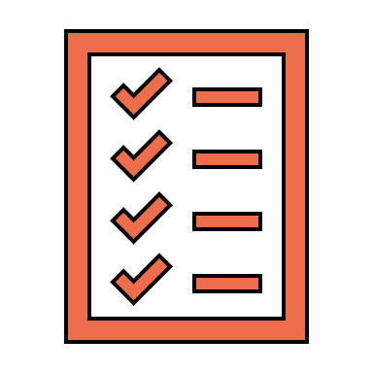
TESTING
5.1 Approach to Testing the Game Logic:
5.1.1. Unit Tests:
Unit tests are essential for verifying that individual components of the game logic work as expected. I would write unit tests for the following functions:
• Initialization Function: Ensure that the game board is initialized correctly.
• Move Validation Function: Verify that moves are only accepted if they are within bounds and the target cell is empty.
• Win Condition Check Function: Check that the function correctly identifies winning conditions for both players.
• Draw Condition Check Function: Confirm that the function accurately detects a draw when all cells are filled with no winner.
• Game Reset Function: Ensure that resetting the game board works correctly.

Slide 10
Manual Testing:
Manual testing complements unit tests by allowing for exploratory testing and the validation of the overall user experience. This involves:
• Playing the Game: Manually playing the game to ensure that the user interface works smoothly and that the game responds correctly to player actions.
• Edge Cases: Testing edge cases, such as making moves in quick succession or trying to make a move after the game has ended.
• User Interface Responsiveness: Checking how the game behaves on different devices and screen sizes to ensure a consistent user experience.
AI Testing
Letting an AI for testing complements unit tests by allowing for exploratory testing and the validation of the overall game functions. This involves:
• Iteratively checking the function: AI checks all functions iteratively to make sure that all function & parameters are properly working.
• Edge Cases: Testing edge cases, such as making moves in quick succession or trying to make a move after the game has ended.
• Faults and lags: Checking how the game behaves on different devices and its workload etc.

Slide 11
THANK YOU

